Slide 1
Eigenvalues and Eigenvectors
Geetha Sivaraman
Assistant Professor
Department of Mathematics
St. Joseph’s College Tiruchirappalli
7.1

Slide 2
1 Eigenvalues and Eigenvectors
Eigenvalue problem (one of the most important problems in the linear algebra):
If A is an n×n matrix, do there exist nonzero vectors x in R^{n} such that Ax is a scalar multiple of x?
(
Eigenvalue and Eigenvector:
A: an n×n matrix
λ: a scalar (could be zero)
x: a nonzero vector in R^{n}
※ Geometric Interpretation
Eigenvalue
Eigenvector

Slide 3
Ex 1: Verifying eigenvalues and eigenvectors
Eigenvalue
※ In fact, for each eigenvalue, it has infinitely many eigenvectors. For λ = 2, [3 0]^{T} or [5 0]^{T} are both corresponding eigenvectors. Moreover, ([3 0] + [5 0])^{T} is still an eigenvector. The proof is in Thm. 7.1.
Eigenvector
Eigenvalue
Eigenvector

Slide 4
Thm. 7.1: The eigenspace corresponding to λ of matrix A
If A is an n×n matrix with an eigenvalue λ, then the set of all eigenvectors of λ together with the zero vector is a subspace of R^{n}. This subspace is called the eigenspace (特徵空間) of λ
Pf:
x₁ and x₂ are eigenvectors corresponding to λ
Since this set is closed under vector addition and scalar multiplication, this set is a subspace of R^{n} according to Theorem 4.5

Slide 5
Ex 3: Examples of eigenspaces on the xy-plane
For the matrix A as follows, the corresponding eigenvalues are λ₁ = –1 and λ₂ = 1:
Sol:
For the eigenvalue λ₁ = –1, corresponding vectors are any vectors on the x-axis
※ Thus, the eigenspace corresponding to λ = –1 is the x-axis, which is a subspace of R²
For the eigenvalue λ₂ = 1, corresponding vectors are any vectors on the y-axis
※ Thus, the eigenspace corresponding to λ = 1 is the y-axis, which is a subspace of R²

Slide 6
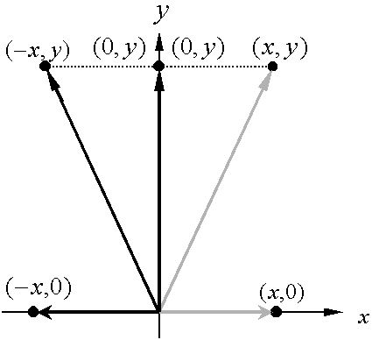
※ Geometrically speaking, multiplying a vector (x, y) in R² by the matrix A corresponds to a reflection to the y-axis

Slide 7
Thm. 0.2: Finding eigenvalues and eigenvectors of a matrix A∈M_{n×n}
Let A be an n×n matrix.
(1) An eigenvalue of A is a scalar λ such that
(2) The eigenvectors of A corresponding to λ are the nonzero
solutions of
Note: follwing the definition of the eigenvalue problem
(homogeneous system)
has nonzero solutions for x iff
(The above iff results comes from the equivalent conditions on Slide 4.101)
Characteristic equation (特徵方程式) of A:
Characteristic polynomial (特徵多項式) of A∈M_{n×n}:

Slide 8
Ex 4: Finding eigenvalues and eigenvectors
Sol: Characteristic equation:
Eigenvalue:

Slide 10
Ex 5: Finding eigenvalues and eigenvectors
Find the eigenvalues and corresponding eigenvectors for the matrix A. What is the dimension of the eigenspace of each eigenvalue?
Sol: Characteristic equation:
Eigenvalue:

Slide 11
The eigenspace of λ = 2:
Thus, the dimension of its eigenspace is 2

Slide 12
Notes:
(1) If an eigenvalue λ₁ occurs as a multiple root (k times) for the characteristic polynominal, then λ₁ has multiplicity k
(2) The multiplicity of an eigenvalue is greater than or equal to the dimension of its eigenspace. (In Ex. 5, k is 3 and the dimension of its eigenspace is 2)

Slide 13
Ex 6：Find the eigenvalues of the matrix A and find a basis
for each of the corresponding eigenspaces
Sol: Characteristic equation:
※ According to the note on the previous slide, the dimension of the eigenspace of λ₁ = 1 is at most to be 2
※ For λ₂ = 2 and λ₃ = 3, the demensions of their eigenspaces are at most to be 1
Eigenvalues:

Slide 14
is a basis for the eigenspace corresponding to
※The dimension of the eigenspace of λ₁ = 1 is 2

Slide 15
is a basis for the eigenspace corresponding to
※The dimension of the eigenspace of λ₂ = 2 is 1

Slide 16
is a basis for the eigenspace corresponding to
※The dimension of the eigenspace of λ₃ = 3 is 1

Slide 17
Thm. 7.3: Eigenvalues for triangular matrices
If A is an n×n triangular matrix, then its eigenvalues are the entries on its main diagonal
Ex 7: Finding eigenvalues for triangular and diagonal matrices
Sol:
※According to Thm. 3.2, the determinant of a triangular matrix is the product of the entries on the main diagonal

Slide 18
Eigenvalues and eigenvectors of linear transformations:
※ The definition of linear transformation functions should be introduced in Ch 6
※ Here I briefly introduce the linear transformation and its some basic properties
※ The typical example of a linear transformation function is that each component of the resulting vector is the linear combination of the components in the input vector x
An example for a linear transformation T: R³→R³

Slide 19
Theorem: Standard matrix for a linear transformation

Slide 20
Consider the same linear transformation T(x₁, x₂, x₃) = (x₁ + 3x₂, 3x₁ + x₂, –2x₃)
Thus, the above linear transformation T is with the following corresponding standard matrix A such that T(x) = Ax
※ The statement on Slide 7.18 is valid because for any linear transformation T: V →V, there is a corresponding square matrix such that T(x) = Ax. Consequently, the eignvalues and eigenvectors of a linear transformation T are in essence the eigenvalues and eigenvectors of the corresponding square matrix A

Slide 21
Ex 8: Finding eigenvalues and eigenvectors for standard matrices
※ A is the standard matrix for T(x₁, x₂, x₃) = (x₁ + 3x₂, 3x₁ + x₂, –2x₃) (see Slides 7.19 and 7.20)
Sol:

Slide 22
Transformation matrix for nonstandard bases
※ On the next two slides, an example is provided to verify numerically that this extension is valid

Slide 23
EX. Consider an arbitrary nonstandard basis to be {v₁, v₂, v₃}= {(1, 1, 0), (1, –1, 0), (0, 0, 1)}, and find the transformation matrix such that corresponding to the same linear transformation T(x₁, x₂, x₃) = (x₁ + 3x₂, 3x₁ + x₂, –2x₃)

Slide 24
Consider x = (5, –1, 4), and check that corresponding to the linear transformation T(x₁, x₂, x₃) = (x₁ + 3x₂, 3x₁ + x₂, –2x₃)

Slide 25
For a special basis $B^{′}=\left\{v_{1},v_{2},…,v_{n}\right\}$, where $v_{i}$’s are eigenvectors of the standard matrix $A$, $A^{′}$is obtained immediately to be diagonal due to
$T\left(v_{i}\right)=Av_{i}=λ_{i}v_{i}$
and
$${\left[λ_{i}v_{i}\right]}_{B^{′}}={\left[0v_{1}+0v_{2}+⋯+λ_{i}v_{i}+⋯+0v_{n}\right]}_{B^{′}}={\left[0⋯0 λ_{i} 0⋯0\right]}^{T}$$

Slide 26
7.2 Diagonalization
Diagonalization problem
For a square matrix A, does there exist an invertible matrix P such that P^{–1}AP is diagonal?
Diagonalizable matrix
Definition 1: A square matrix A is called diagonalizable if there exists an invertible matrix P such that P^{–1}AP is a diagonal matrix (i.e., P diagonalizes A)
Definition 2: A square matrix A is called diagonalizable if A is similar to a diagonal matrix
※ In Sec. 6.4, two square matrices A and B are similar if there exists an invertible matrix P such that B = P^{–1}AP.
Notes:
In this section, I will show that the eigenvalue and eigenvector problem is closely related to the diagonalization problem

Slide 27
Thm. 7.4: Similar matrices have the same eigenvalues
If A and B are similar n×n matrices, then they have the same eigenvalues
Pf:
For any diagonal matrix in the form of D = λI, P^{–1}DP = D
Consider the characteristic equation of B:
Since A and B have the same characteristic equation, they are with the same eigenvalues
※ Note that the eigenvectors of A and B are not identical

Slide 28
Ex 1: Eigenvalue problems and diagonalization programs
Sol: Characteristic equation:

Slide 29
Note: If
※ The above example can verify Thm. 7.4 since the eigenvalues for both A and P^{–1}AP are the same to be 4, –2, and –2
※ The reason why the matrix P is constructed with the eigenvectors of A is demonstrated in Thm. 7.5 on the next slide

Slide 30
Thm. 7.5: Condition for diagonalization
An n×n matrix A is diagonalizable if and only if it has n linearly independent eigenvectors
※ If there are n linearly independent eigenvectors, it does not imply that there are n distinct eigenvalues. In an extreme case, it is possible to have only one eigenvalue with the multiplicity n, and there are n linearly independent eigenvectors for this eigenvalue
※ On the other hand, if there are n distinct eigenvalues, then there are n linearly independent eigenvectors (see Thm. 7.6), and thus A must be diagonalizable
Pf:

Slide 32
※

Slide 33
Ex 4: A matrix that is not diagonalizable
Sol: Characteristic equation:
Since A does not have two linearly independent eigenvectors, A is not diagonalizable

Slide 34
Steps for diagonalizing an n×n square matrix:
Step 1: Find n linearly independent eigenvectors for A with corresponding eigenvalues
Step 2: Let
Step 3:

Slide 35
Ex 5: Diagonalizing a matrix
Sol: Characteristic equation:

Slide 38
Note: a quick way to calculate A^{k} based on the diagonalization technique

Slide 39
Thm. 7.6: Sufficient conditions for diagonalization
If an n×n matrix A has n distinct eigenvalues, then the corresponding eigenvectors are linearly independent and thus A is diagonalizable according to Thm. 7.5.
Pf:
Let λ₁, λ₂, …, λ_{n} be distinct eigenvalues and corresponding eigenvectors be x₁, x₂, …, x_{n}. In addition, consider that the first m eigenvectors are linearly independent, but the first m+1 eigenvectors are linearly dependent, i.e.,
where c_{i}’s are not all zero. Multiplying both sides of Eq. (1) by A yields

Slide 40
On the other hand, multiplying both sides of Eq. (1) by λ_{m+1} yields
Now, subtracting Eq. (2) from Eq. (3) produces
Since the first m eigenvectors are linearly independent, we can infer that all coefficients of this equation should be zero, i.e.,
Because all the eigenvalues are distinct, it follows all c_{i}’s equal to 0, which contradicts our assumption that x_{m+1} can be expressed as a linear combination of the first m eigenvectors. So, the set of n eigenvectors is linearly independent given n distinct eigenvalues, and according to Thm. 7.5, we can conclude that A is diagonalizable

Slide 41
Ex 7: Determining whether a matrix is diagonalizable
Sol: Because A is a triangular matrix, its eigenvalues are
According to Thm. 7.6, because these three values are distinct, A is diagonalizable

Slide 42
Ex 8: Finding a diagonalized matrix for a linear transformation
Sol:
The standard matrix for T is given by
From Ex. 5 you know that λ₁ = 2, λ₂ = –2, λ₃ = 3 and thus A is diagonalizable. So, similar to the result on Slide 7.25, these three linearly independent eigenvectors found in Ex. 5 can be used to form the basis . That is

Slide 43
The matrix for T relative to this basis is
※ Note that it is not necessary to calculate through the above equation. According to the result on Slide 7.25, we already know that is a diagonal matrix and its main diagonal entries are corresponding eigenvalues of A

Slide 44
7.3 Symmetric Matrices and Orthogonal Diagonalization
Symmetric matrix :
A square matrix A is symmetric if it is equal to its transpose:
Ex 1: Symmetric matrices and nonsymetric matrices
(symmetric)
(symmetric)
(nonsymmetric)

Slide 45
Thm 7.7: Eigenvalues of symmetric matrices
If A is an n×n symmetric matrix, then the following properties are true
(1) A is diagonalizable (symmetric matrices (except the matrices in the form of D = aI) are guaranteed to have n linearly independent eigenvectors and thus be diagonalizable)
(2) All eigenvalues of A are real numbers
(3) If λ is an eigenvalue of A with the multiplicity to be k, then λ has k linearly independent eigenvectors. That is, the eigenspace of λ has dimension k
※ The above theorem is called the Real Spectral Theorem , and the set of eigenvalues of A is called the spectrum of A

Slide 46
Ex 2:
Prove that a 2 × 2 symmetric matrix is diagonalizable
Pf: Characteristic equation:
As a function in λ, this quadratic polynomial function has a nonnegative discriminant as follows

Slide 47
※ Note that in this case, A has one eigenvalue, a, and its multiplicity is 2
The characteristic polynomial of A has two distinct real roots, which implies that A has two distinct real eigenvalues. According to Thm. 7.6, A is diagonalizable

Slide 48
Orthogonal matrix:
A square matrix P is called orthogonal if it is invertible and
Thm. 7.8: Properties of orthogonal matrices
An n×n matrix P is orthogonal if and only if its column vectors form an orthonormal set
Pf: Suppose the column vectors of P form an orthonormal set, i.e.,
It implies that P^{–1} = P^{T} and thus P is orthogonal

Slide 49
Ex 5: Show that P is an orthogonal matrix.
Sol: If P is a orthogonal matrix, then

Slide 51
Thm. 7.9: Properties of symmetric matrices
Let A be an n×n symmetric matrix. If λ₁ and λ₂ are distinct eigenvalues of A, then their corresponding eigenvectors x₁ and x₂ are orthogonal. (Thm. 7.6 only states that eigenvectors corresponding to distinct eigenvalues are linearly independent)
Pf:
※ For distinct eigenvalues of a symmetric matrix, their corresponding eigenvectors are orthogonal and thus linearly independent to each other
※ Note that there may be multiple x₁ and x₂ corresponding to λ₁ and λ₂

Slide 52
Orthogonal diagonalization (正交對角化):
A matrix A is orthogonally diagonalizable if there exists an orthogonal matrix P such that P^{–1}AP = D is diagonal
Thm. 7.10: Fundamental theorem of symmetric matrices
Let A be an n×n matrix. Then A is orthogonally diagonalizable and has real eigenvalues if and only if A is symmetric
Pf:
See the next two slides

Slide 53
Orthogonal diagonalization of a symmetric matrix:
Let A be an n×n symmetric matrix.
(1) Find all eigenvalues of A and determine the multiplicity of each
(2) For each eigenvalue of multiplicity 1, choose the unit eigenvector
(3) For each eigenvalue of the multiplicity to be k ≥ 2, find a set of k linearly independent eigenvectors. If this set {v₁, v₂, …, v_{k}} is not orthonormal, apply the Gram-Schmidt orthonormalization process
※ According to Thm. 7.9, eigenvectors corresponding to distinct eigenvalues are orthognoal

Slide 54
(4) The composite of steps (2) and (3) produces an orthonormal set of n eigenvectors. Use these orthonormal and thus linearly independent eigenvectors as column vectors to form the matrix P.
i. According to Thm. 7.8, the matrix P is orthogonal
ii. Following the diagonalization process on Slide 7.35, D = P^{–1}AP is diagonal
Therefore, the matrix A is orthogonally diagonalizable

Slide 55
Ex 7: Determining whether a matrix is orthogonally diagonalizable
Symmetric
matrix
Orthogonally
diagonalizable

Slide 56
Ex 9: Orthogonal diagonalization
Sol:
※ Verify Thm. 7.9 that v₁·v₂ = v₁·v₃ = 0
orthogonal

Slide 57
※If v₂ and v₃ are not orthogonal, the Gram-Schmidt Process should be performed. Here we simply normalize v₂ and v₃ to find the corresponding unit vectors
※ Note that there are some calculation error in the solution of Ex.9 in the text book

Slide 58
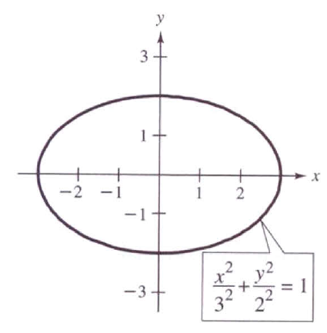
7.4 Applications of Eigenvalues and Eigenvectors
The rotation for quadratic equation: ax²+bxy+cy²+dx+ey+f = 0
Ex 5: Identify the graphs of the following quadratic equations
Sol:
※ Since there is no xy-term, it is easy to derive the standard form and it is apparent that this equation represents an ellipse.

Slide 59
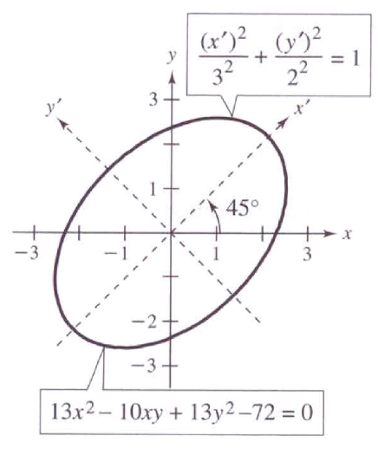
※ Since there is a xy-term, it is difficult to identify the graph of this equation. In fact, it is also an ellipse, which is oblique on the xy-plane.
※ There is a easy way to identify the graph of quadratic equation. The basic idea is to rotate the x- and y-axes to x’- and y’-axes such that there is no more x’y’-term in the new quadratic equation.
※ In the above example, if we rotate the x- and y-axes by 45 degree counterclockwise, the new quadratic equation can be derived, which represents an ellipse apparently.
※ In Section 4.8, the rotation of conics is achieved by changing basis, but here the diagonalization technique based on eigenvalues and eignvectors is applied to solving the rotation problem

Slide 60
Quadratic form (二次形式):
ax² + bxy + cy²
is the quadratic form associated with the quadratic equation ax² + bxy + cy² + dx + ey + f = 0
Matrix of the quadratic form:
If we define X = , then X^{T}AX= ax² + bxy + cy² . In fact, the quadratic equation can be expressed in terms of X as follows
※ Note that A is a symmetric matrix

Slide 61
Principal Axes Theorem
For a conic whose equation is ax² + bxy + cy² + dx + ey + f = 0, the rotation to eliminate the xy-term is achieved by X = PX’, where P is an orthogonal matrix that diagonalizes A. That is,
where λ₁ and λ₂ are eigenvalues of A. The equation for the rotated conic is given by

Slide 62
Pf:
According to Thm. 7.10, since A is symmetric, we can conclude that there exists an orthogonal matrix P such that P^{–1}AP = P^{T}AP = D is diagonal
Replacing X with PX’, the quadratic form becomes
※ It is obvious that the new quadratic form in terms of X’ has no x’y’-term, and the coefficients for (x’)² and (y’)² are the two eigenvalues of the matrix A
※

Slide 63
Ex 6: Rotation of a conic
Perform a rotation of axes to eliminate the xy-term in the following quadratic equation
Sol:
The matrix of the quadratic form associated with this equation is
The eigenvalues are λ₁ = 8 and λ₂ = 18, and the corresponding eigenvectors are

Slide 64
After normalizing each eigenvector, we can obtain the orthogonal matrix P as follows.
※ According to the results on p. 268 in Ch4, X=PX’ is equivalent to rotate the xy-coordinates by 45 degree to form the new x’y’-coordinates, which is also illustrated in the figure on Slide 7.62
Then by replacing X with PX’, the equation of the rotated conic is
which can be written in the standard form
※ The above equation represents an ellipse on the x’y’-plane

Slide 65
In three-dimensional version:
ax² + by² + cz² + dxy + exz + fyz
is the quadratic form associated with the equation of quadric surface: ax² + by² + cz² + dxy + exz + fyz + gx + hy + iz + j = 0
Matrix of the quadratic form:
If we define X = [x y z]^{T}, then X^{T}AX= ax² + by² + cz² + dxy + exz + fyz, and the quadratic surface equation can be expressed as
※ Note that A is a symmetric matrix

Slide 66
7.5 Principal Component Analysis
Principal component analysis
It is a way of identifying the underlying patterns in data
It can extract information in a large data set with many variables and approximate this data set with fewer factors
In other words, it can reduce the number of variables to a more manageable set
Steps of the principal component analysis
Step 1: Get some data
Step 2: Subtract the mean
Step 3: Calculate the covariance matrix
Step 4: Calculate the eigenvectors and eigenvalues of the
covariance matrix
Step 5: Deriving the transformed data set
Step 6: Getting the original data back

Slide 67
Step 1:
Step 2:
x | y
2.5 | 2.4
0.5 | 0.7
2.2 | 2.9
1.9 | 2.2
3.1 | 3.0
2.3 | 2.7
2.0 | 1.6
1.0 | 1.1
1.5 | 1.6
1.1 | 0.9
1.81 | 1.91
x | y
0.69 | 0.49
-1.31 | -1.21
0.39 | 0.99
0.09 | 0.29
1.29 | 1.09
0.49 | 0.79
0.19 | -0.31
-0.81 | -0.81
-0.31 | -0.31
-0.71 | -1.01
0 | 0
Step 3:

Slide 68
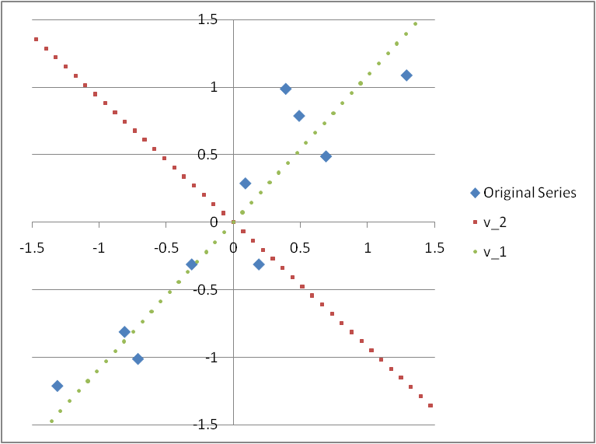
Step 4: Calculate the eigenvectors and eigenvalues of the covariance matrix A
1. The two eigenvectors are perpendicular (orthogonal) to each other according to Thm. 7.9 (In fact, they are orthonormal here)
2. v₁ eigenvector (corresponding to the largest eigenvalue $λ_{1}$) is just like a best-fit regression line
3. v₂ seems less important to explain the data since the projection of each node on the v₂ axis is very close to zero
4. The interpretation of v₁ is the new axis which retains as much as possible the interpoint distance information (or the variance information) that was contained in the original two dimensions

Slide 69
※ The intuition behind the principal component analysis:
(It also implies that the new series of x’ and y’ are independent)

Slide 70
Step 5: Deriving the transformed data set:
x’ | y’
-0.82797 | -0.17512
1.77758 | 0.14286
-0.99220 | 0.38437
-0.27421 | 0.13042
-1.67580 | -0.20950
-0.91295 | 0.17528
0.09911 | -0.34982
1.14457 | 0.04642
0.43805 | 0.01776
1.22382 | -0.16268
0 | 0
x’ | y’
-0.82797 | 0
1.77758 | 0
-0.99220 | 0
-0.27421 | 0
-1.67580 | 0
-0.91295 | 0
0.09911 | 0
1.14457 | 0
0.43805 | 0
1.22382 | 0
0 | 0

Slide 71
Step 6: Getting the original data back:
case 1 case 2
x | y
2.5 | 2.4
0.5 | 0.7
2.2 | 2.9
1.9 | 2.2
3.1 | 3
2.3 | 2.7
2 | 1.6
1 | 1.1
1.5 | 1.6
1.1 | 0.9
1.81 | 1.91
x | y
2.37 | 2.52
0.61 | 0.60
2.48 | 2.64
2.00 | 2.11
2.95 | 3.14
2.43 | 2.58
1.74 | 1.84
1.03 | 1.07
1.51 | 1.59
0.98 | 1.01
1.81 | 1.91
※ We can derive the original data set if we take both v₁ and v₂ and thus x’ and y’ into account when deriving the transformed data
※ Although when we derive the transformed data, only v₁ and thus only x’ are considered, the data gotten back is still similar to the original data. That means, x’ can be a common factor almost able to explain both series x and y

Slide 72
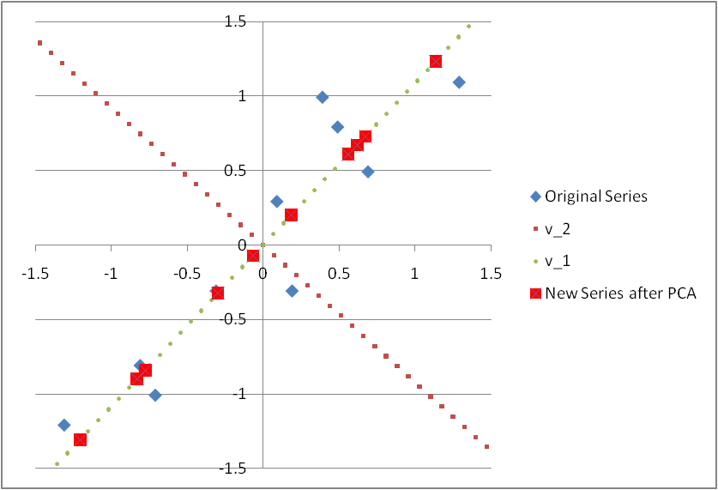
※ If only the principal component x’ is considered in the Principal Component Analysis (PCA), it is equivalent to project all points onto the v₁ vector
※ It can be observed in the above figure that the projection onto v₁ vector can retains as much as possible the interpoint distance information (variance) that was contained in the original series of (x, y)

Slide 73
Factor loadings: the correlations between the principal components (F₁ = x’ and F₂ = y’) and the original variables (x₁ = x and x₂ = y)
Factor loadings are used to identify and interpret the unobservable principal components
※ The factor loadings of x’ on x and y are close to 1 in absolute levels, which implies the principal component x’ can explain x and y quite well and thus x’ can viewed as an index to represent the combined information of x and y

